Slide 1
Tableau Presentation
Presented by:
Nikita Sali
Guided by:
Ashwini Kakade

Slide 2
What is Tableau ?
Tableau is a business intelligence tool for visually analyzing the data. Users can create and distribute an interactive and shareable dashboard, which depict the trends, variations, and density of the data in the form of graphs and charts.

Slide 3
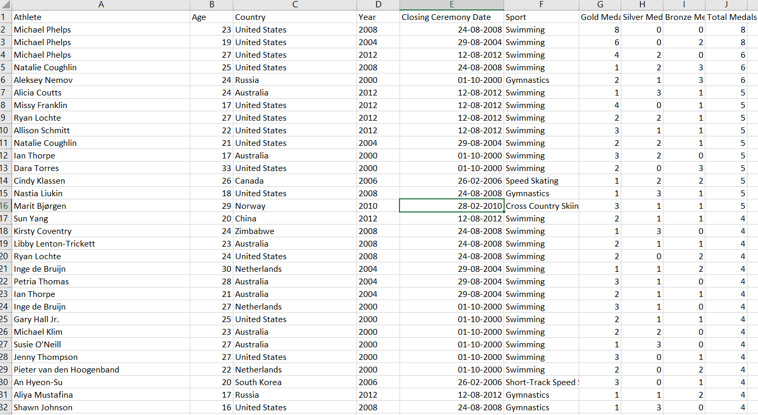

Slide 4
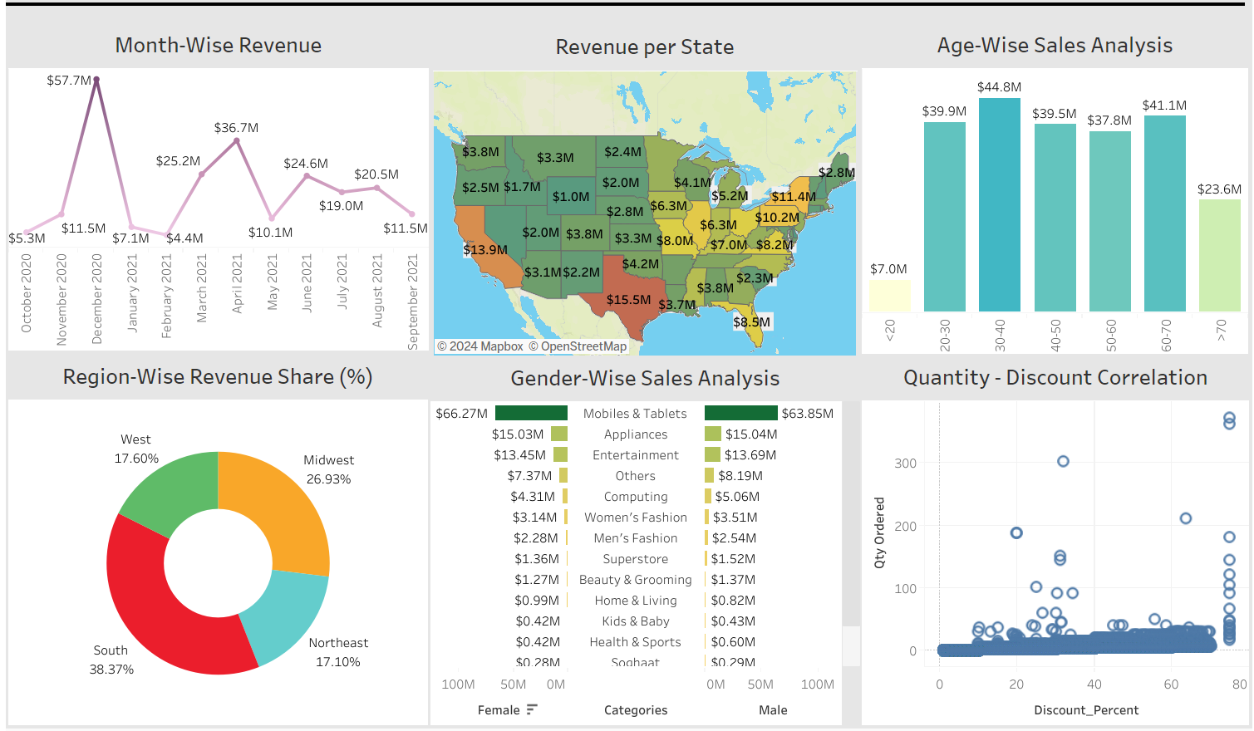
Charts in Tableau
24+ different charts supported by tableau

Slide 5
Tools offered by tableau
Tableau desktop
Tableau online
Tableau server
Tableau reader
Tableau public

Slide 6
Databases supported by tableau
Spreadsheets
Database
Big data
Hadoop
Cloud applications
50+ databases

Slide 7
Places to publish results
Desktop
Tablet
Phone

Slide 8
Why use tableau ?
Speed
User-friendly
Interactive dashboard
Direct connection
Easy publish & share

Slide 9
How to install tableau
https://www.tableau.com/support/releases/desktop/2023.1

Slide 10
Netflix Analysis

Slide 11
Lets Go…

